Slide 1
Big data and big pharma – looking for hidden trends in clinical trials
Helen MacBain
Capstone project

Slide 2
The question
Is there another use for GSK’s medicines that we are missing?
Trial investigators are looking for one effect from a medicine
But what if something else is happening that they are not looking for?
GSK has a wealth of data from patients in trials so it may be possible to spot other effects
64
Number of trials in the GSK database

Slide 3
Glucose
The prize is high – diabetes is a growing global epidemic
Spotting a reduction in glucose in a group of patients may indicate a new product to tackle diabetes
Glucose is measured routinely in any patient in a clinical trial so the data exists
Phase 3 trials enlist the most patients so are the best place to start looking for potential effects on glucose
422 million
Number of patients globally with type 2 diabetes

Slide 4
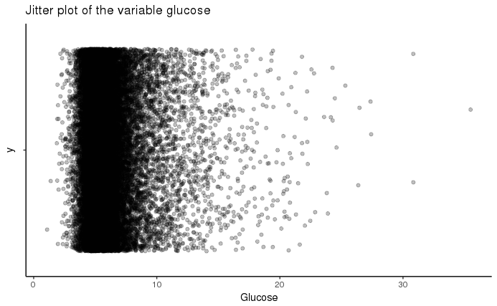
What’s ‘normal’ for glucose
Looking at the range of measurements in all Phase 3 data
A plot showing every glucose result in all the phase 3 trials GSK has conducted in the last 10 years
Usual range for normal glucose is 3.9 – 6.9 mmol/L
There’s a lot of points outside of this range so there is potential that a trend might be spotted in the data

Slide 5
Examine the trials
Pick the three biggest trials in the dataset for analysis
Therapy Area | Indication | Phase | No of patients
Respiratory | Chronic Obstrucitve Pulmonary Disease | Phase IIIA | 1532
Respiratory | Chronic Obstrucitve Pulmonary Disease | Phase IIIA | 1633
Respiratory | Chronic Obstrucitve Pulmonary Disease | Phase IIIA | 1622

Slide 6
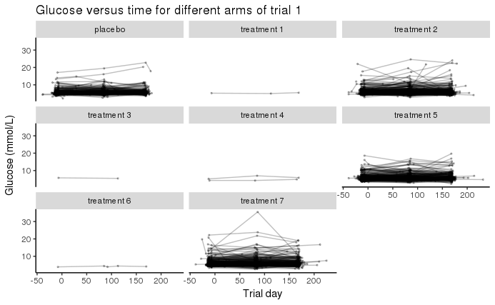
Looking at Phase 3 trials
What do the different arms look like?
A grid of plots showing glucose measures (y) against time (x) in the different arms of the trial
Some arms have just one or two patients so these need to be removed as they won’t be statistically significant.

Slide 7
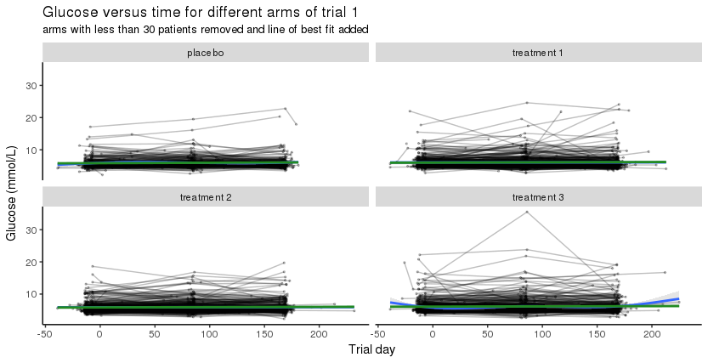
Examine the data in detail
Create models to see if there are any trends in glucose
Plot of the four arms in Trial DB2113373 with a significant number of patients
A crude linear model has been added
Further detailed machine modelling was conducted to try and spot hidden changes in glucose

Slide 8
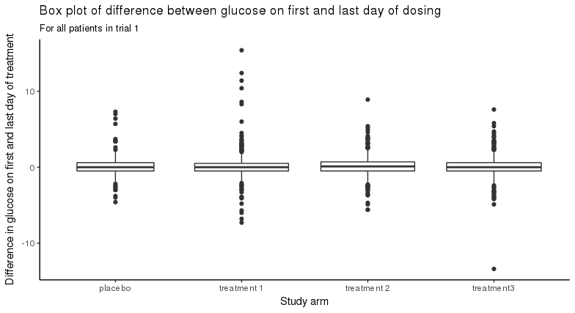
Take it further
Look at the glucose levels on first and last day of dosing
Bar plot of the mean difference between glucose levels on the first and last day of treatment
Split into different arms – patients receiving different doses

Slide 9
Last chance….
Look at the absolute figures to see if there’s anything
Study arm | No of patients | Mean of differences | SD of differences | Median of differences
PLACEBO | 279 | 0.08956833 | 1.347520 | 0.0000000
UMEC 62.5 | 416 | 0.17142856 | 1.947642 | 0.0000000
UMEC/VI 62.5/25 | 413 | 0.15496368 | 1.448704 | 0.0999999
VI 25 | 421 | 0.06380953 | 1.530213 | 0.0000000
Table of the mean, standard deviation and median differences between glucose levels on the first and last day of treatment
Split into different arms – patients receiving different doses

Slide 10
Conclusion
Nothing to see here yet, but……
No effect on glucose from the medicine tested in these three trials
There are 64 studies to check
There are other ways to cut the data – age, gender, ethnicity…
There are other measures to look at

